Slide 1

COMPUTER SCIENCE INVESTIGATORY PROJECT
Name:
S. BALAVIGNESH REDDY
Class: 12-A
Roll no.:

Slide 2
Project name
Student Report Card Management

Slide 3
INDEX
Certificate
Acknowledgement
Working Description
Coding Screen
Output Screen
Bibliography

Slide 4

CERTIFICATE
This is to certify that S. Balavignesh Reddy, Roll no. __________, Class 12A of Hillwoods School has successfully completed his Computer Science investigatory project on the topic “Student’s Report Card Management Project” as prescribed by CBSE in the academic session 2021-2022.
INTERNAL EXAMINER
HEAD OF THE SCHOOL
EXTERNAL EXAMINER
SCHOOL STAMP

Slide 5
Acknowledgement
I would like to express my special thanks and gratitude to my Computer Science Teacher Ms. Khushboo Gupta as well as our Vice-Principal Ms. Kiran Upadhyay for guiding me immensely through the course of the project. Her constructive advice and constant motivation have been responsible for the successful completion of this project.
Secondly, I would also like to thank my parents and friends who helped me a lot in finalizing this project within the limited time frame.

Slide 6
Working Description
This program is designed to keep the student’s record.
This program consist of NINE options as follows
1. Add student
2. Delete the student Record
3. Modify student record
4. Add marks to New Student
5. Delete the Marks Record of student

Slide 7
6. Modify student’s report
7. Search Menu
1. Search Student
2. Search Student’s Term Marks
3. Back to Main part
8. Report Card Menu
1. Single term Report Card
2. Whole class Report Card
3. Whole session Report Card
4. Class wise Toppers
5. Back to main menu
9. Close application

Slide 8

Code for My SQL
1

Slide 9
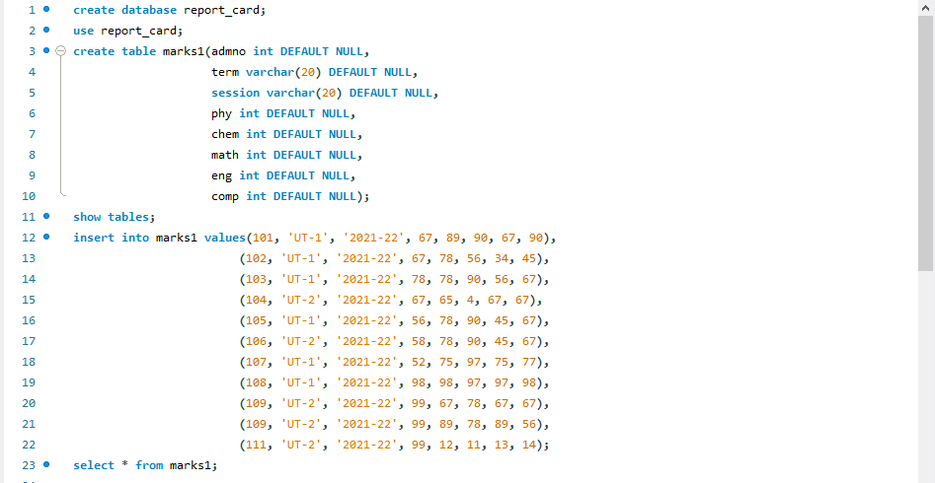
MY SQL CODE

Slide 10
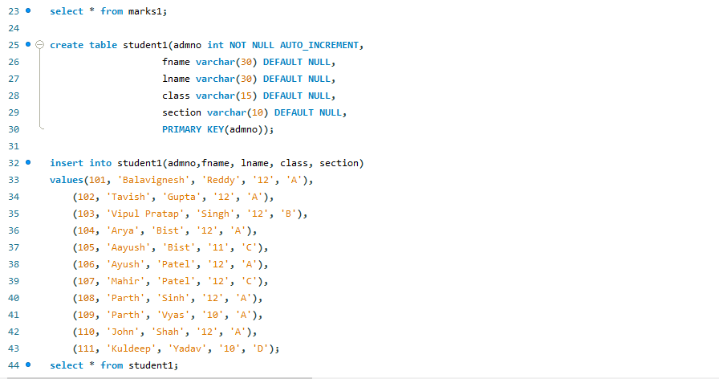
MY SQL CODE

Slide 11

Code for Python

Slide 12
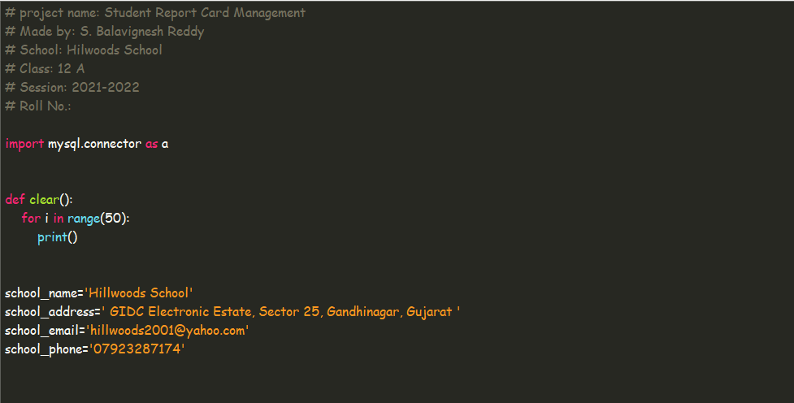
INTRODUCTION

Slide 13
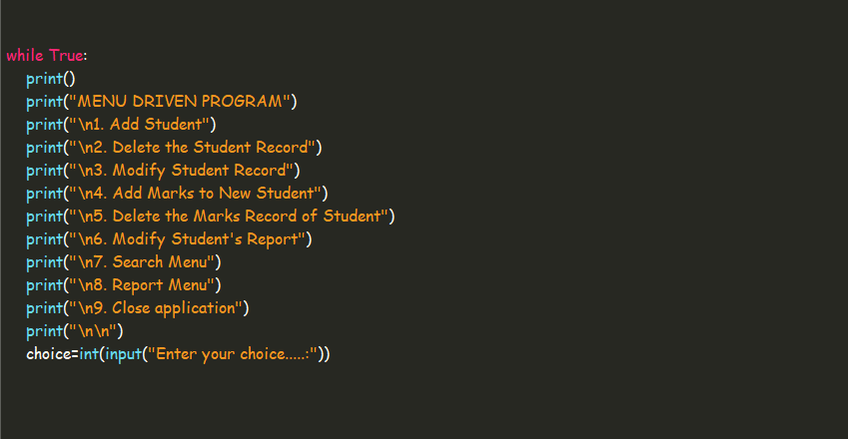
PROGRAM’S MENU

Slide 14
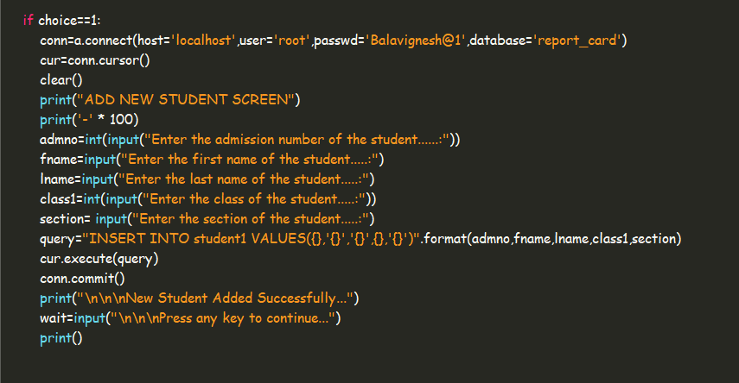
PROGRAM FOR ADD NEW STUDENT

Slide 15
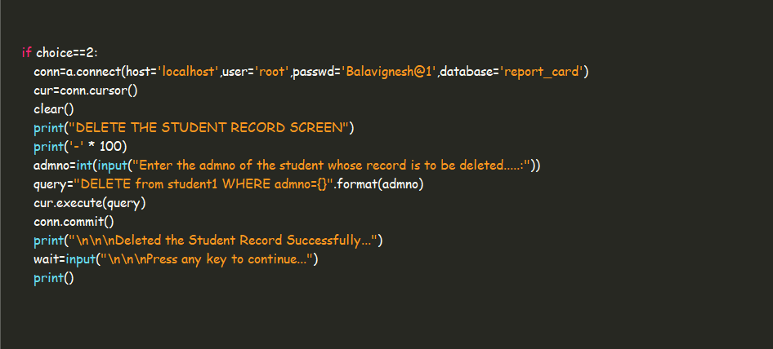
PROGRAM FOR DELETE STUDENT RECORD

Slide 16
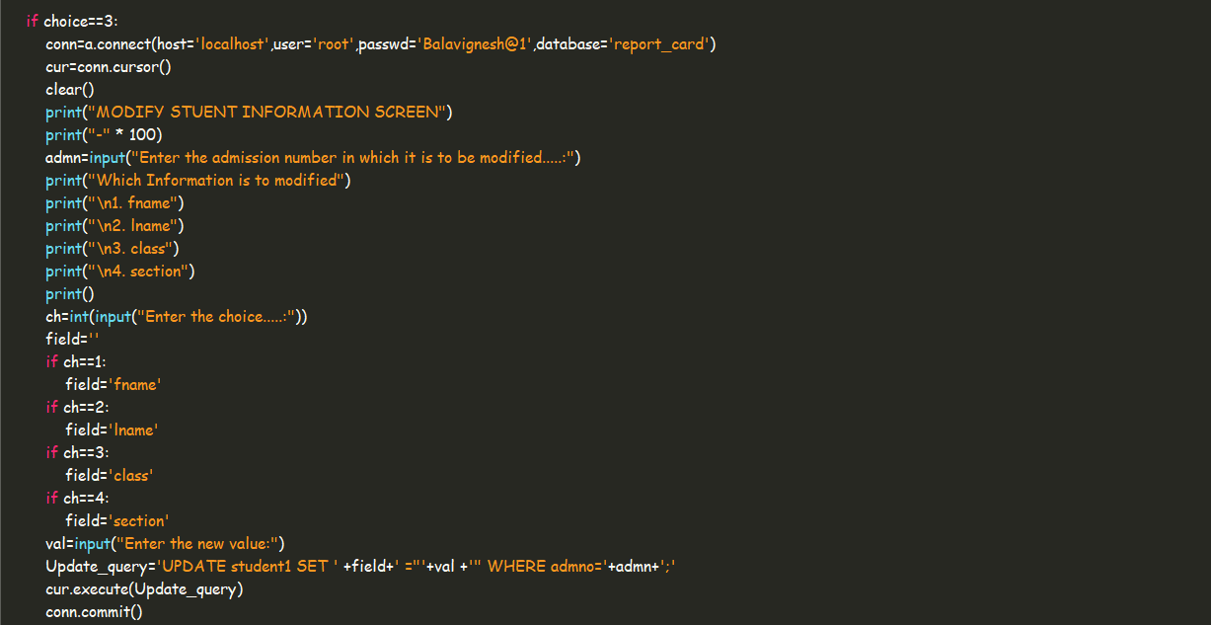
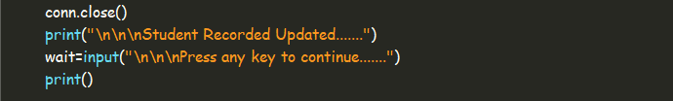
PROGRAM FOR MODIFY STUDENT’S RECORD

Slide 17
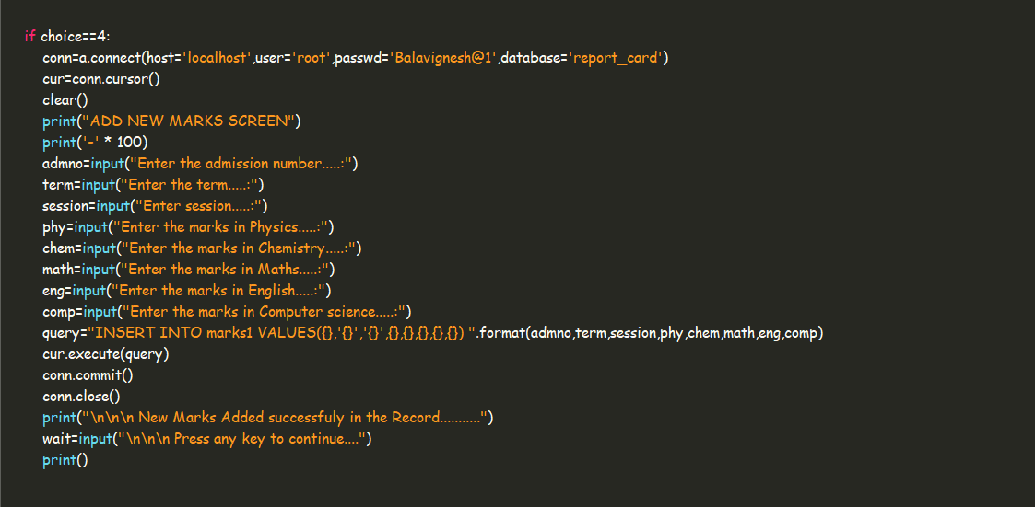
PROGRAM FOR ADDING NEW MARKS

Slide 18
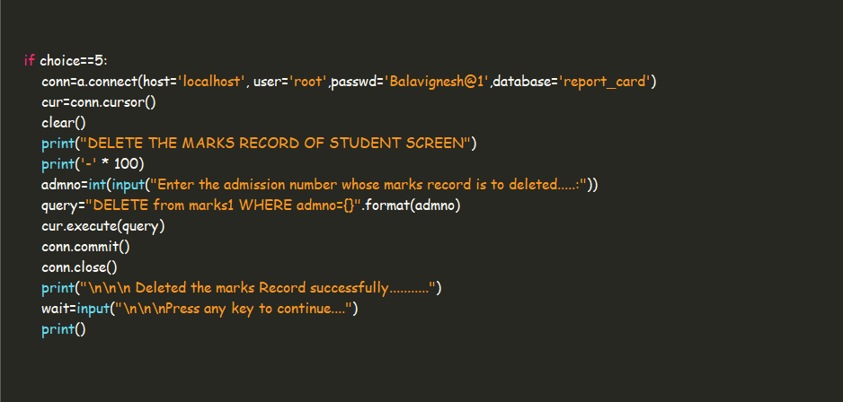
PROGRAM FOR DELETING MARKS RECORD

Slide 19
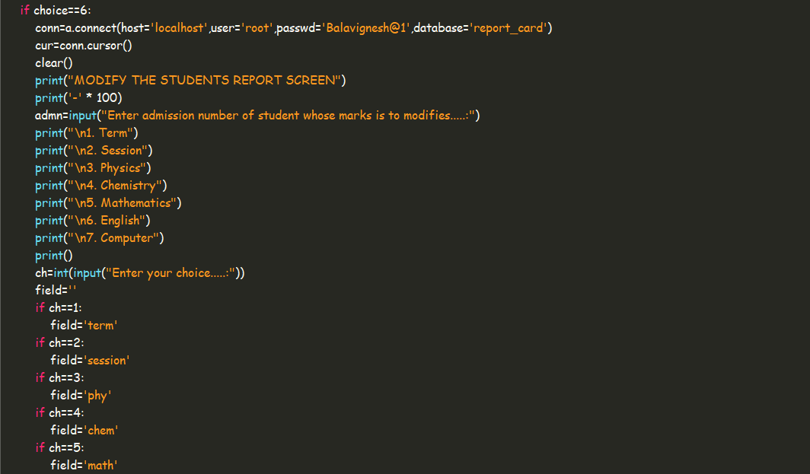
PROGRAM FOR MODIFY MARKS RECORD

Slide 20
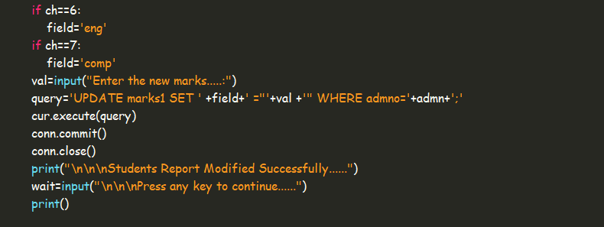
PROGRAM FOR MODIFY MARKS RECORD

Slide 21
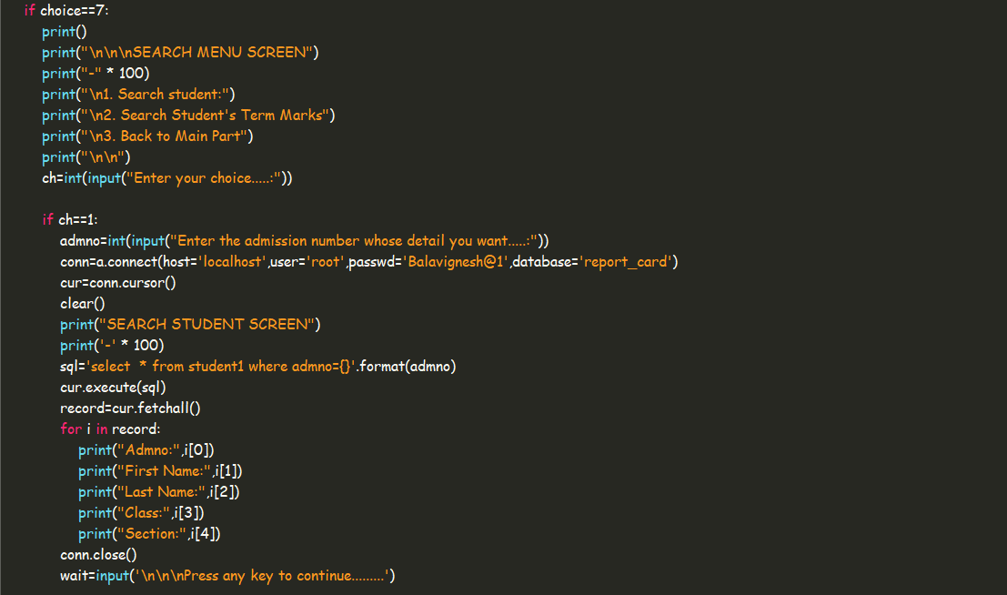
SERACH MENU AND PROGRAM FOR SEARCH STUDENT MENU

Slide 22
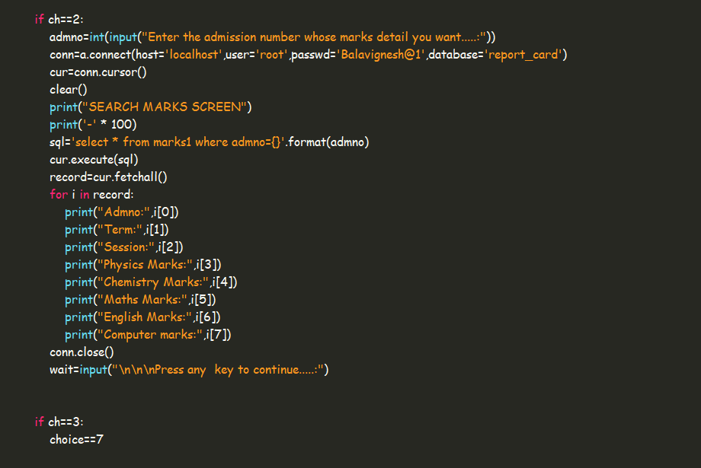
PROGRAM FOR SEARCH STUDENT’S TERM MARKS AND PROGRAM FOR BACK TO MAIN MENU

Slide 23
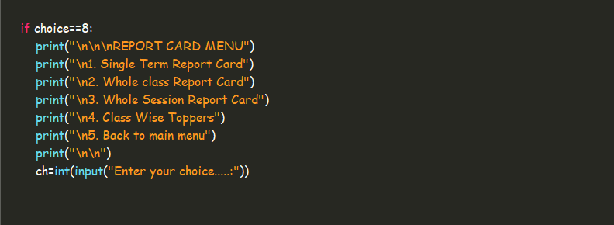
REPORT MENU

Slide 24
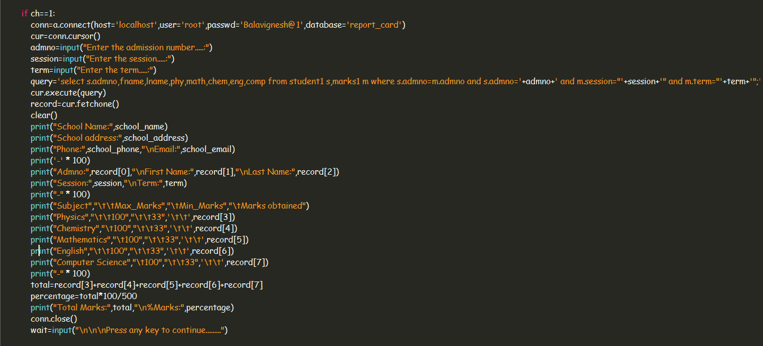
PROGRAM FOR SINGLE TERM REPORT CARD

Slide 25
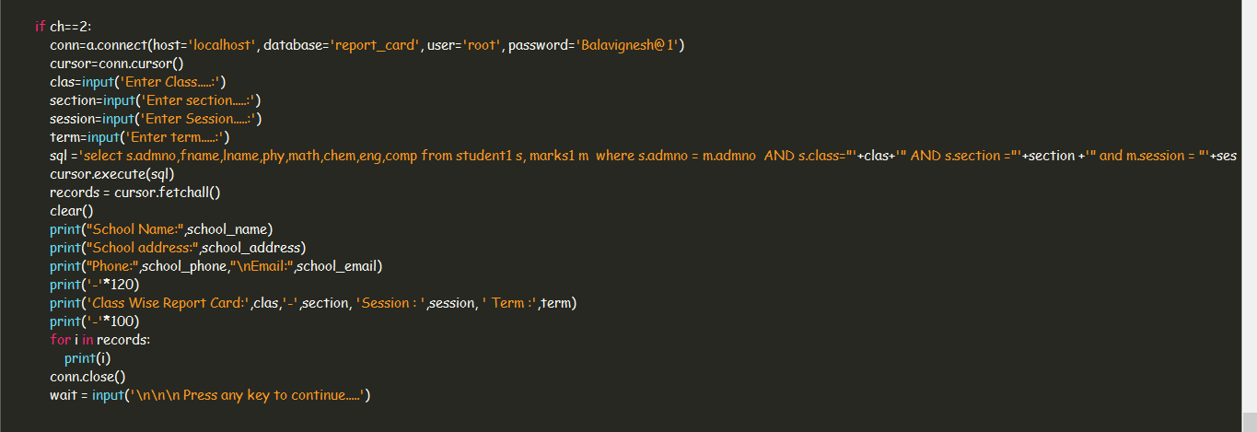
PROGRAM FOR WHOLE CLASS REPORT CARD

Slide 26
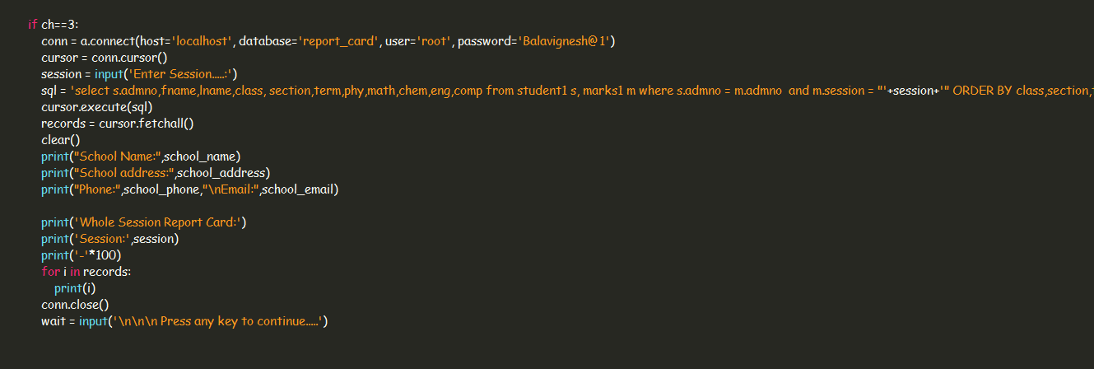
PROGRAM FOR WHOLE SESSION REPORT CARD

Slide 27
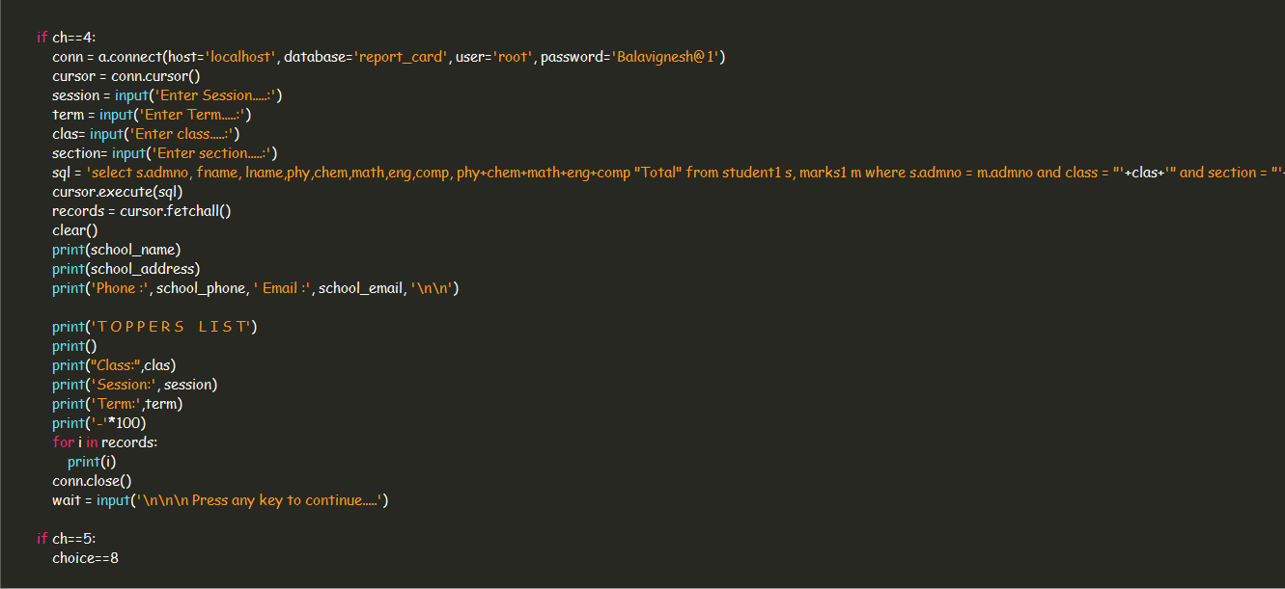
PROGRAM FOR CLASS WISE TOPPERS AND BACK TO MAIN MENU

Slide 28
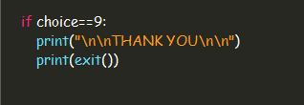

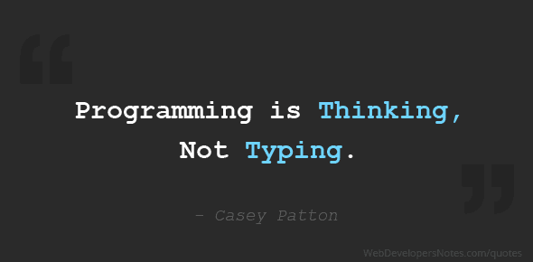
PROGRAM FOR CLOSE APPLICATION

Slide 29
Output for My SQL

Slide 30
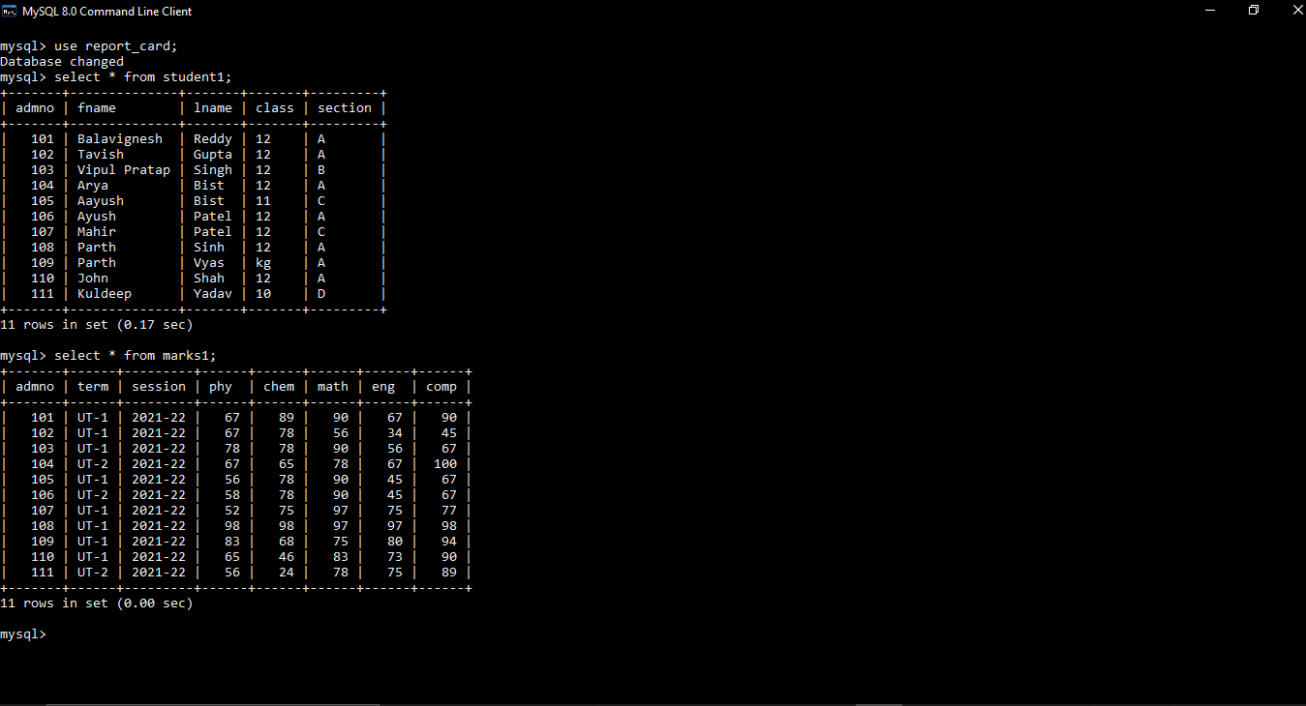

Slide 31
Output for Python

Slide 32
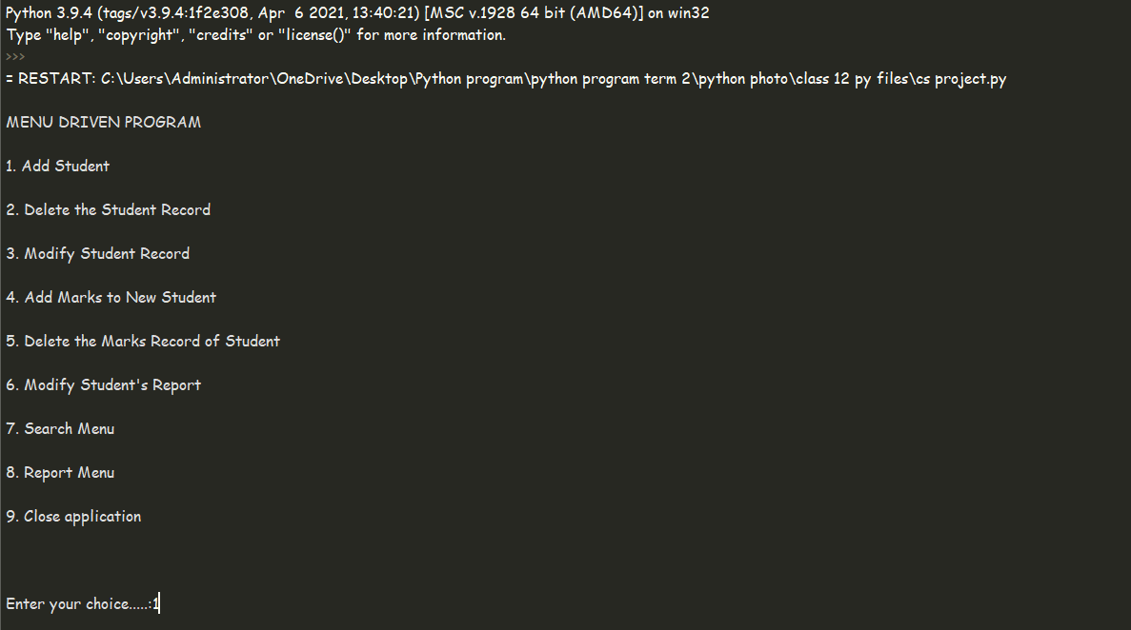

Slide 33
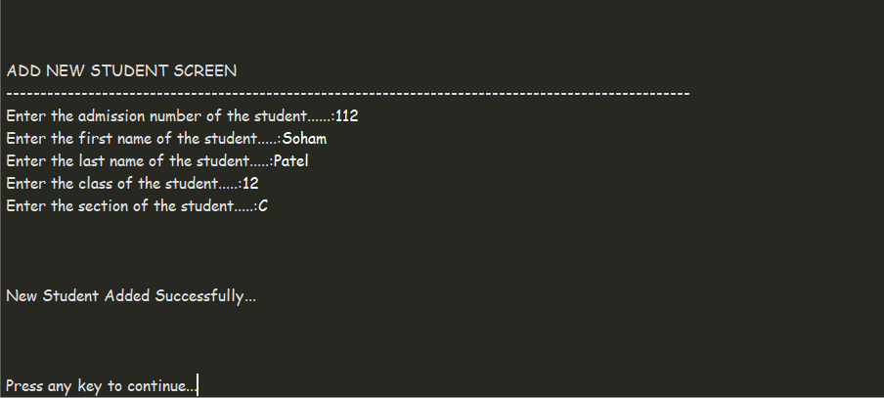
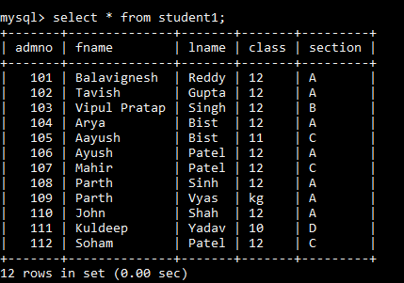
OUTPUT FOR ADD NEW STUDENT

Slide 34
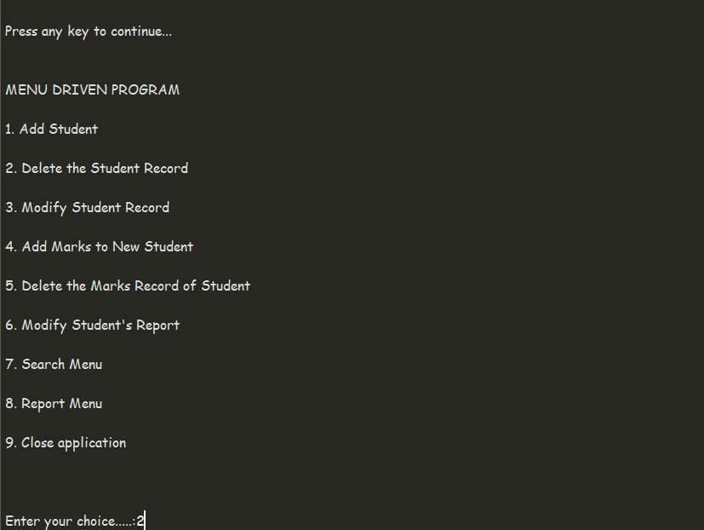
OUTPUT FOR DELETE STUDENT RECORD

Slide 35
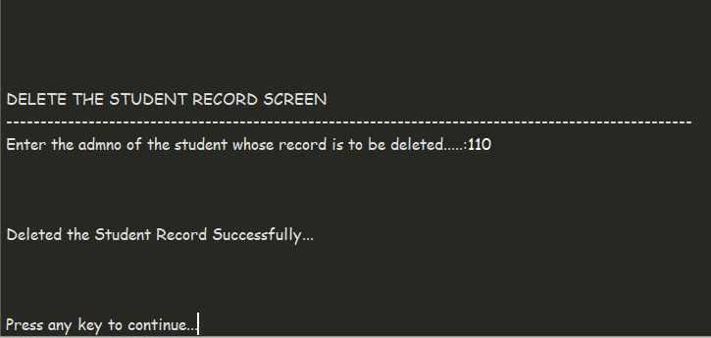
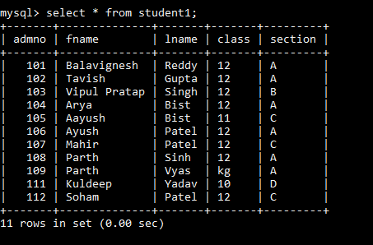
OUTPUT FOR DELETE STUDENT RECORD

Slide 36
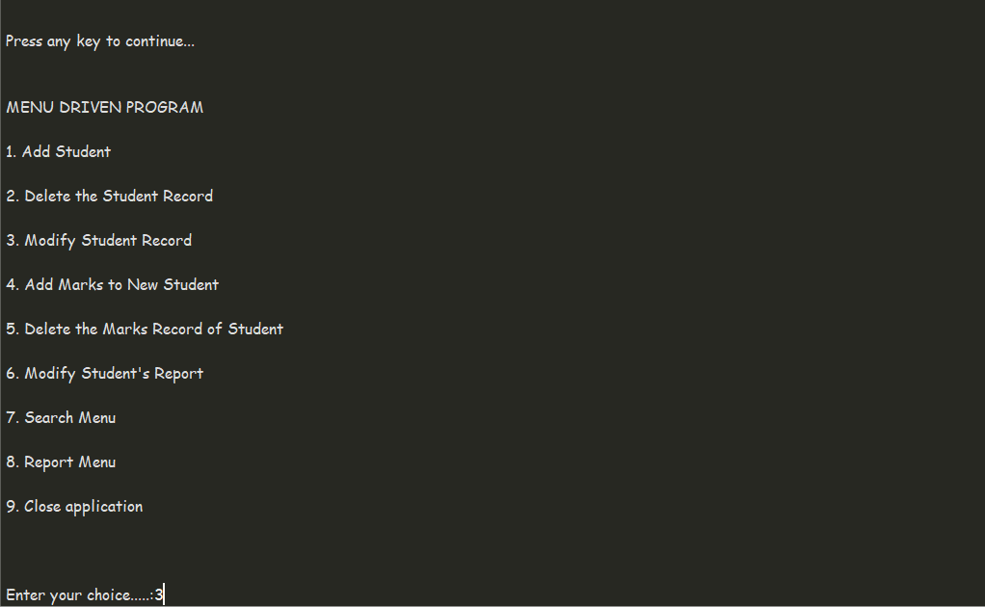
OUTPUT FOR MODIFY STUDENT’S RECORD

Slide 37
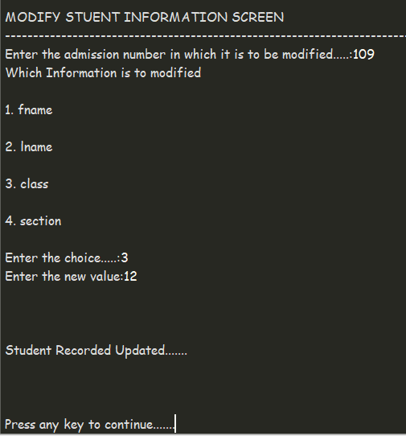
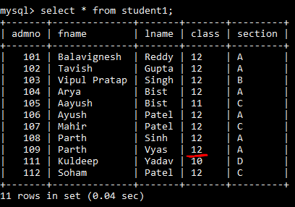
OUTPUT FOR MODIFY STUDENT’S RECORD

Slide 38
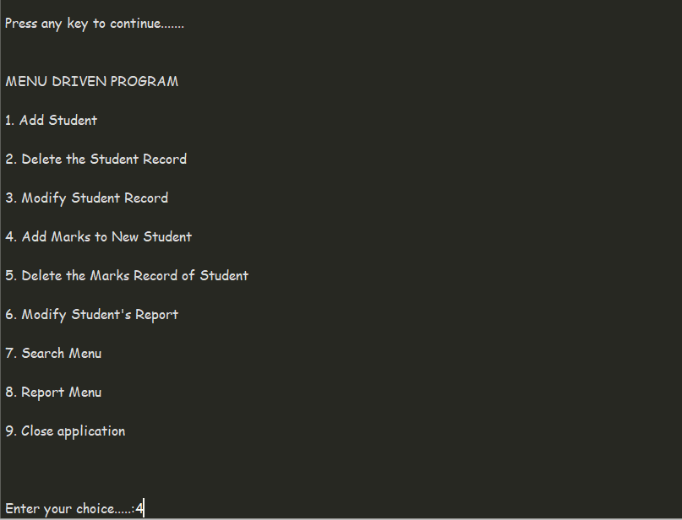
OUTPUT FOR ADDING NEW MARKS

Slide 39
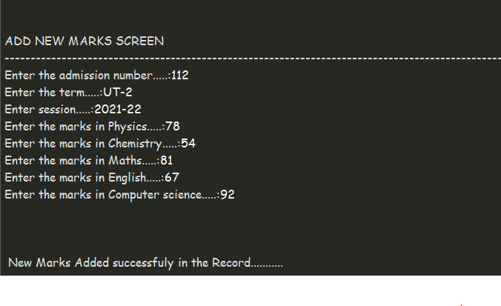
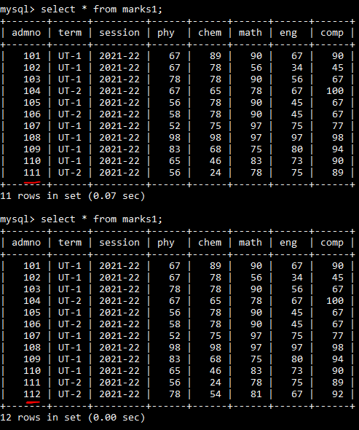
OUTPUT FOR ADDING NEW MARKS

Slide 40
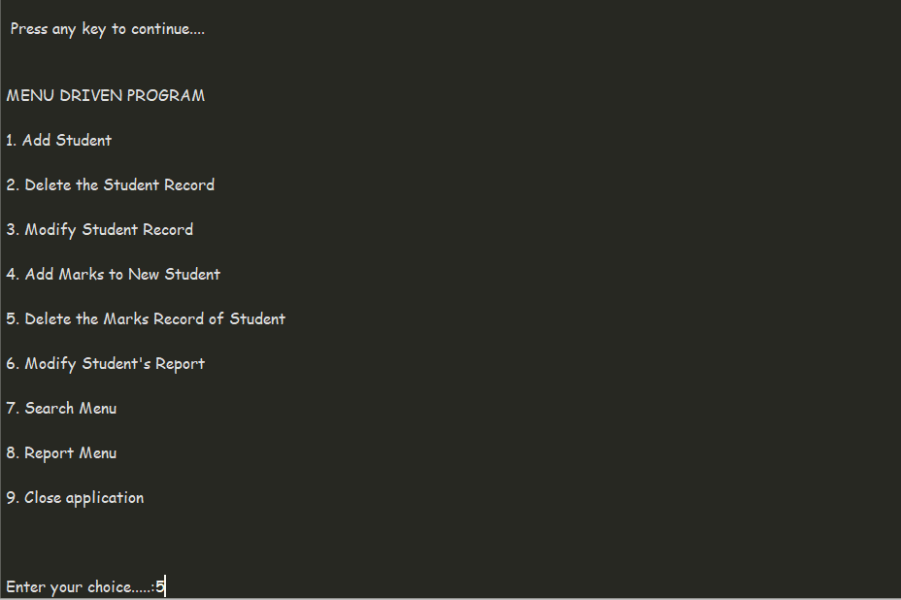
OUTPUT FOR DELETING MARKS RECORD

Slide 41
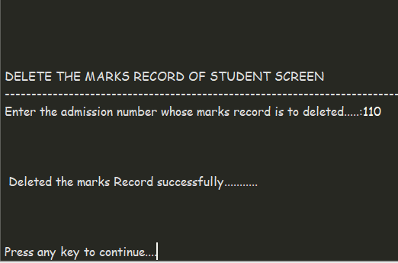
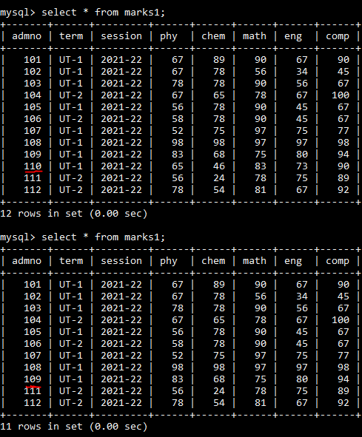
OUTPUT FOR DELETING MARKS RECORD

Slide 42
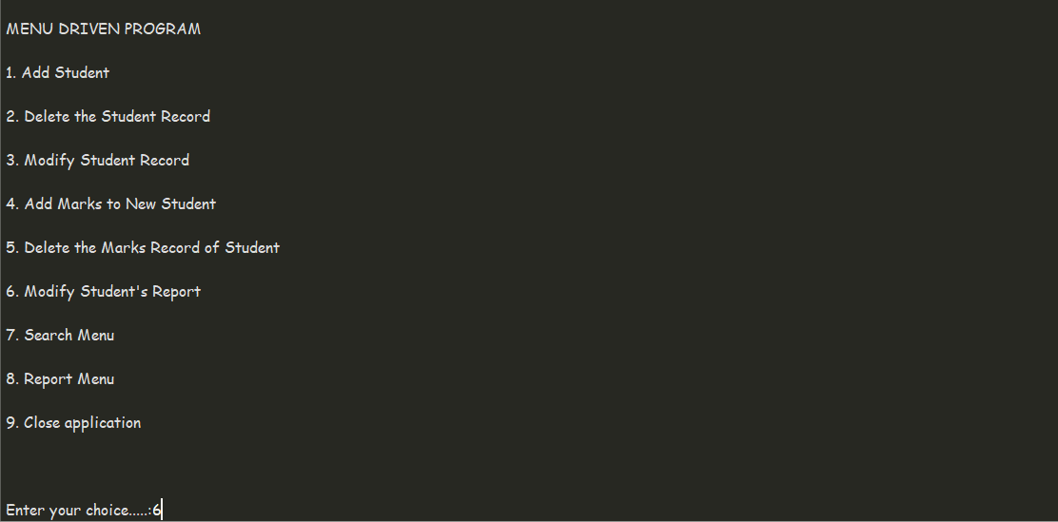
OUTPUT FOR MODIFY MARKS RECORD

Slide 43
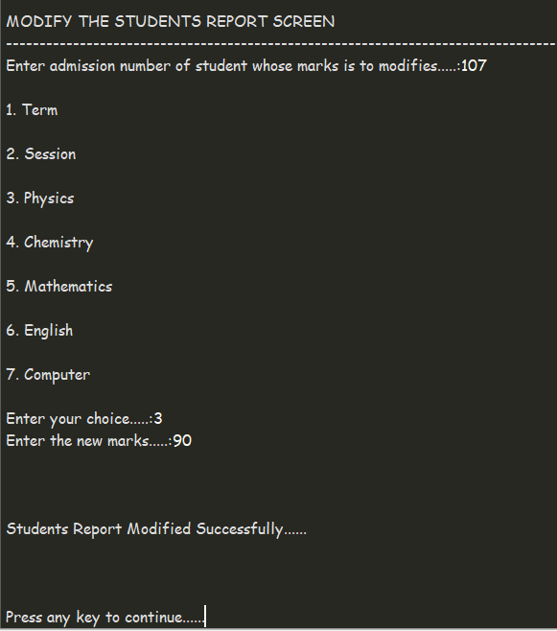
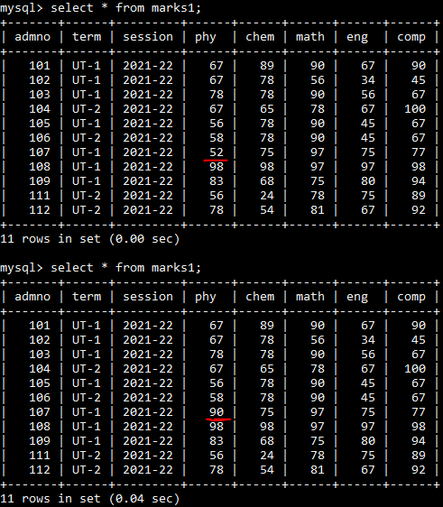
OUTPUT FOR MODIFY MARKS RECORD

Slide 44
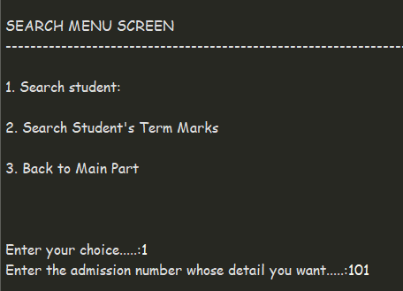
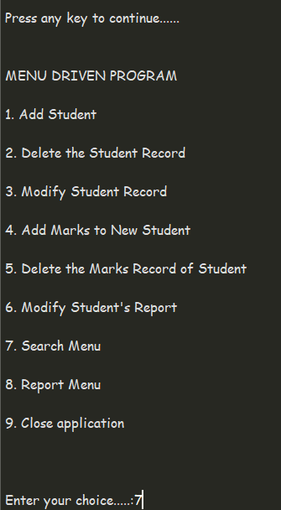
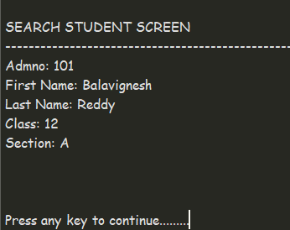
OUTPUT FOR SEARCH MENU

Slide 45
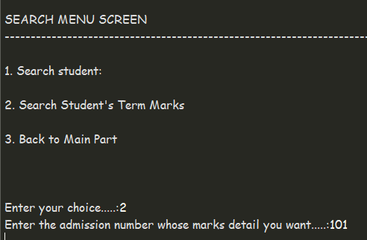
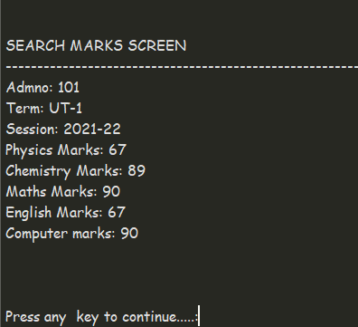
OUTPUT FOR SEARCH MENU

Slide 46
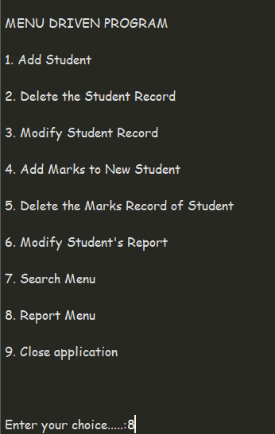
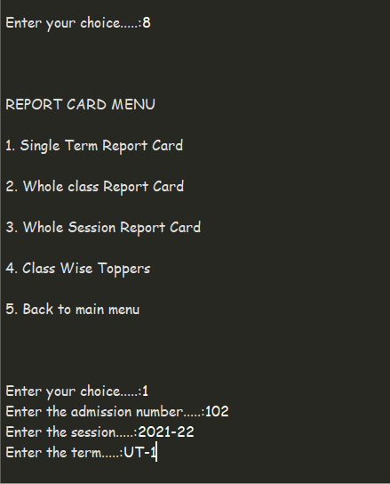
OUTPUT FOR REPORT MENU

Slide 47
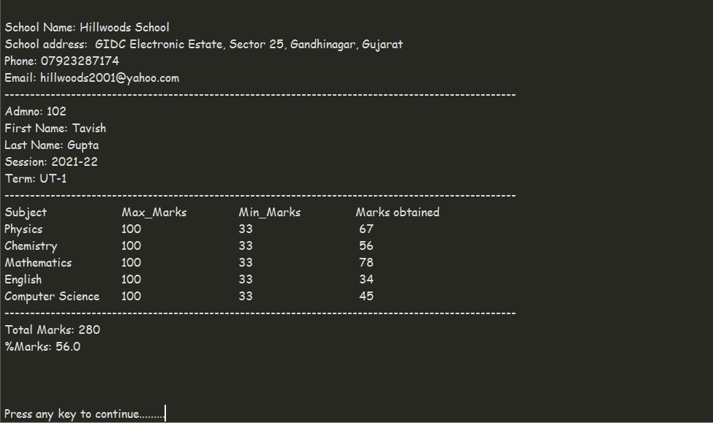
OUTPUT FOR REPORT MENU

Slide 48
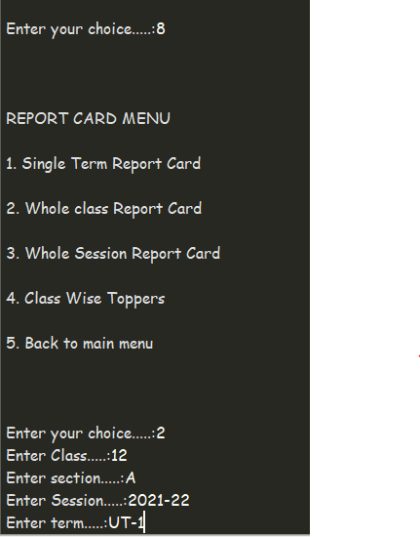
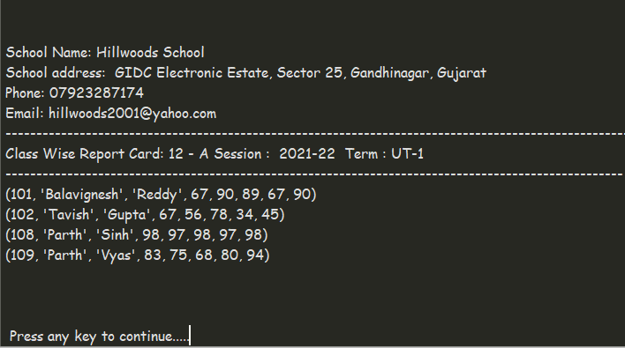
OUTPUT FOR REPORT MENU

Slide 49


OUTPUT FOR REPORT MENU

Slide 50


OUTPUT FOR REPORT MENU

Slide 51



OUTPUT FOR CLOSE APPLICATION

Slide 52
Bibliography
Computer Textbook
www.google.com
www.youtube.com
www.cbsetoday.com

Slide 53



